Slide 1

Chapter 6
Platform Games
Game Development 1.1
Denis McCarthy
E-mail: demccarthy@ait.ie
Room: U302

Slide 2
Platform Games
Platform games are very common, in particular on handheld devices.
In a platform game you look at the scene from the side.
The player normally controls a character that walks around in the world.
This world consists of platforms. The player can:
  walk on these platforms
  jump or drop from one platform to the other
  use ladders or ropes
to get to different places, etc.
Game Development 1.1
Denis McCarthy

Slide 3
Platform Games (cont)
On the platforms there are:
  Objects to collect
  Enemies to avoid or kill (often either by shooting them or by jumping on top of them),
  Switches that can be pressed to open passages, etc.
  Items that can be pushed to achieve some objective.
  Also the player normally requires skill to jump over dangerous areas such as moving platforms etc.
In some platform games you see the whole level at once, but in most you see only a part around the character. In such a case, finding your way around becomes an additional challenge.
Game Development 1.1
Denis McCarthy

Slide 4
Platform Games (cont)
Creating a good platform game is not trivial, also not with GM.
There are three important aspects to take into account:
  Creating natural motion for the character.
  Creating enough variation in monsters, background, etc.
  Carefully designing the levels such that they are fun to play and get increasingly difficult.
In this tutorial you will learn how to make a simple platform game.
We will build the game in a number of steps. And it will consist of just one level to demonstrate some particular aspect.
You can use them as a basis for your own platform games.
Once again as an assignment you will be asked to create 5 levels to demonstrate your knowledge gained.
Game Development 1.1
Denis McCarthy

Slide 5
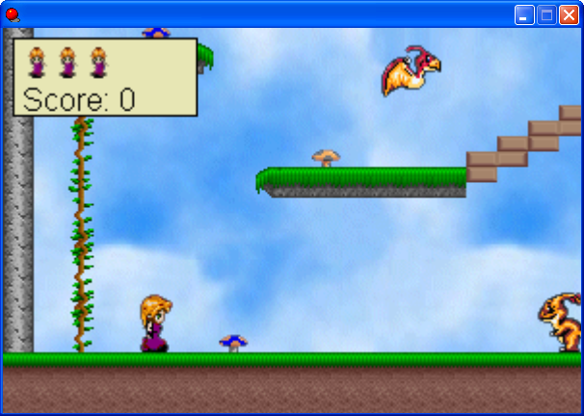
Alice not in Wonderland
“Alice is trapped in a not
so wonderful land. It is
inhabited by giant rabbits
and large birds that are
preventing Alice from
returning home. Guide
Alice safely home and if
you have to blast your
way home, then so be it!”
Game Development 1.1
Denis McCarthy

Slide 6
Game Framework
As we have discussed previously, from now on you will be given the game framework with all of the resources required to get it up an running.
As part of the assignment to create levels you can add new resources as required.
Game Development 1.1
Denis McCarthy

Slide 7
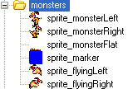
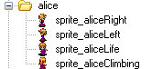
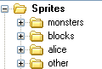
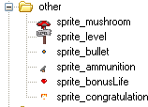
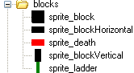
Framework: Sprites
The sprites have been categorised into directories for ease of use.
Game Development 1.1
Denis McCarthy

Slide 8
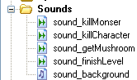
Framework: Sounds
A number of sound files have been included also.
Game Development 1.1
Denis McCarthy

Slide 9
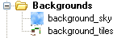
Framework: Backgrounds
A normal blue sky background has been included, also an extra background that we will use as a tile set has also been included. We will look at tile sets in more detail later.
Game Development 1.1
Denis McCarthy

Slide 10



Framework: Objects
As with the sprites the objects have been categorised into directories.
Work in the same way as they did in the Lazarus game, the drawing of the lives and score looks different but the idea is the same.
Game Development 1.1
Denis McCarthy

Slide 11

Framework: Rooms
As in the game Lazarus, the title room has been setup, as well as an empty test level, and finally the congratulations screen.
Game Development 1.1
Denis McCarthy

Slide 12
Where to start?
We have to create a number of objects that do nothing.
These objects have:
  have an image (sprite) associated with them.
  Some have the solid property enabled, so other objects can detect colliding with them.
  no events or actions associated with them.
We are going to create a lot of objects quickly for this game, most of the work is in our character Alice object.
After that, the bulk of the work is involved in creating the level.
Game Development 1.1
Denis McCarthy

Slide 13
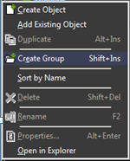
Creating Object Groups
Create the following objects and set the solid property to be enabled.
Group them in a group called blocks.
To create a group, right-click on the Object resources and select create group, call this group “blocks”.
Game Development 1.1
Denis McCarthy

Slide 14

Block objects
These objects will be used to create the platforms and ladder/ropes within the game.
So create the following objects and give them the appropriate sprite:
  object_block → sprite_block
  Object_blockHorizontal → sprite_blockHorizontal
  Object_blockVertical → sprite_blockVertical
  Object_blockDeath→ sprite_death
  Object_blockLadder → sprite_ladder
Make sure to enable the solid property!
Game Development 1.1
Denis McCarthy

Slide 15
Parent power
We want the following 3 objects to act in the same way
  object_block
  object_blockHorizontal
  object_blockVertical
We will be adding the same collision detection to each of the above and also check on when Alice falls on any of them.
This sounds like a lot of work and it is.
We can avoid a lot of this work by using parent power.
Effectively we do all the work on one object and say it is the parent of the other objects, then those other objects inherit all of the events, actions and attributes of the parent.
Game Development 1.1
Denis McCarthy

Slide 16
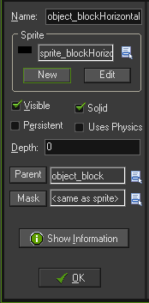
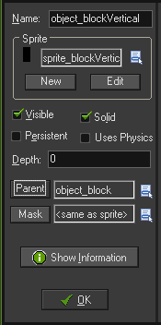
Parent power (cont)
We will use the object_block as the parent, there is no set up involved here.
Within the other two objects we must tell them that the object block is their parent.
Game Development 1.1
Denis McCarthy

Slide 17
Parent power (cont)
Parents can save you hours of repeated work for objects with many events and actions.
You could just duplicate objects to save time, but any changes you want to make afterwards have to be made to both the original and each of the copies you’ve made.
However, when you change a parent, the changes automatically apply to the children of that parent too – a very useful feature.
Next we present a number of rules that determine the way that parents work in different situations.
Game Development 1.1
Denis McCarthy

Slide 18
Parent power (cont)
Inheriting Events:
  A child inherits all the events (and actions) of its parent. A
  child can have its own events as well, but these only apply
  to the child and not the parent. When both the child and
  parent have the same event with different actions, then the
  actions of the child are used for the child, and the actions
  for the parent are used for the parent.
Actions on Objects:
  When an action refers to a parent object, that includes
  instances of the child object as well. However, when an
  action refers to the child object, it does not include
  instances of the parent.
Game Development 1.1
Denis McCarthy

Slide 19
Parent power (cont)
Collision with Objects:
  A collision event with a parent object also applies to
  collisions with children of that object. However a collision
  event with a child object does not apply to collisions with
  parents of that object.
Parenting Objects:
  Parents can have parents, which can have parents etc.
  However, you must not create cycles of parents, so if P is
  the parent if C, then C cannot be the parent of P.
Game Development 1.1
Denis McCarthy

Slide 20

Object Group Other
Create these objects within the group called “other”.
The following 3 objects will be used as item pickups within the game and also a mechanism for exiting a level.
These objects just have a sprite associated with them.
Set the depth to 10 for each object.
No other properties need to be set
  object_bonusLife → sprite_bonusLife
  object_levelExit → sprite_level
  object_ammunition → sprite_ammuniton
Game Development 1.1
Denis McCarthy

Slide 21
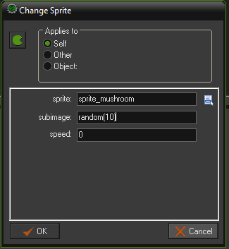
Object Mushroom
Create the object_mushroom within the object group “others”, and give it the sprite sprite_mushroom.
Add a Create event and add a Change Sprite action.
The sprite_mushroom has 10 different mushroom images within it, so we need to randomly select one.
Set the property:
  sprite to sprite_mushroom
  subimage to the function random(10)
  speed to 0, i.e. create instantly
Click on OK to finish.
Set the depth to 10 for the object.
Game Development 1.1
Denis McCarthy

Slide 22
Object_marker
To give the appearance of baddies roaming the platforms we will create markers that they will move back and forth between. This marker object will have no properties set and will only be used in collision detection events with monsters.
Create a new object group called “monsters”
Create a new object called object_marker and give it the sprite_marker.
Game Development 1.1
Denis McCarthy

Slide 23
Monsters
We have two types of monsters in the game:
  Large rabbit (moves left and right on a platform )
  Large bird (flies left and right in the sky)
Jumping on top of it can squash the rabbit; the bird should be avoided at all times.
For these objects we need to set up collision detection events for when they collide with block or markers.
Each monster has two images associated with it, one for moving left, and the other for moving right depending in which direction the monster is travelling.
That’s all we need to setup!
Game Development 1.1
Denis McCarthy

Slide 24
Rabbit Monster
Let's start with the Rabbit monster that moves on the platforms.
We need two sprites for it, one with the Rabbit facing left and the other with the Rabbit facing right.
In the creation event we let it move to the right with a particular speed. Whenever it hits a wall it reverses its horizontal speed.
To set the correct sprite for the monster we use the End Step event.
This event happens just before the instances are drawn.
In it we set the correct sprite based on the value of the variable hspeed that indicates the horizontal speed.
If it is smaller than 0 we let the Rabbit face left and otherwise we let it face right.
(If you have the Pro Edition of Game Maker you can also use the action to mirror the image. In this case you need only one sprite.)
Game Development 1.1
Denis McCarthy

Slide 25
Rabbit Monster (cont)
Create a new object called object_rabbit within the object group “monsters” and give it the sprite sprite_monsterRight.
Add a Create event and to this add a Moved Fixed action with the direction set to right with a speed of 4.
Add a Collision event with the object_block and add the reverse horizontal action to it.
Add a Collision event with the object_marker and add the reverse horizontal action to it.
When the rabbit changes direction we need to change to the sprite associated with that direction.
Game Development 1.1
Denis McCarthy

Slide 26
Rabbit Monster (cont)
The end step event is executed at the end of the step, just before the drawing. This is typically used to change the sprite depending on the current direction.
Add a Step, End Step event to the object_rabbit.
Within GM the horizontal speed of an object is stored in the variable hspeed. We can test this to determine the direction of the Rabbit. When we created the Rabbit object it was moving right with a speed of 4 when it collides with a block or marker it reverse the horizontal effectively setting the object to a negative speed, making it go backwards, we will use this negative value to test for the direction.
Game Development 1.1
Denis McCarthy

Slide 27
Rabbit Monster (cont)
Add a Test Variable action (control tab), test the variable hspeed to see if it is larger that 0.
If hspeed is greater than 0 (moving right) then add a Change Sprite action to set the sprite to sprite_monsterRight.
Else if the hspeed is less than 0 (moving left) then add a Change Sprite action to set the sprite to sprite_monsterLeft.
The actions should look like the next slide.
Game Development 1.1
Denis McCarthy

Slide 28
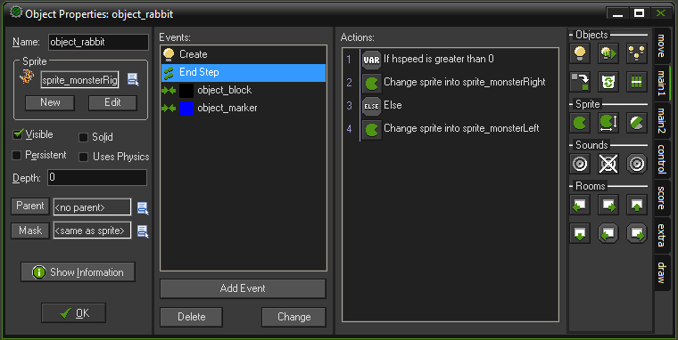
Rabbit Monster (cont)
Game Development 1.1
Denis McCarthy

Slide 29
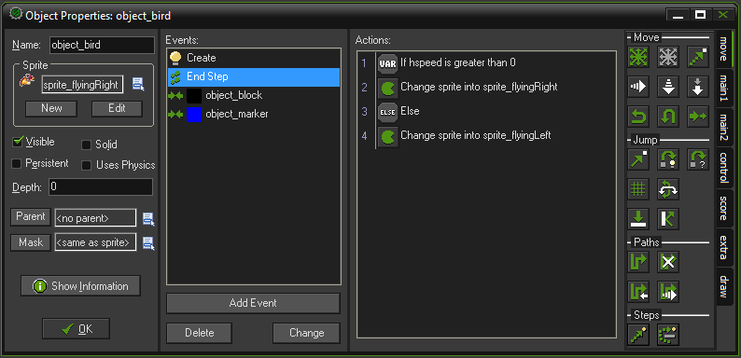
Bird Monster
The flying Bird monster works in the same way as the Rabbit monster except that its images are different, so create the object_bird to resemble object_rabbit.

Slide 30
Bullet object
Alice will be able to shoot the monsters (if she can find some ammo, more on this later).
We will add all of our collision detection for when a bullet collides with anything, within the bullet object itself.
Create a new object called object_bullet and add it to the object group “other” and give it the sprite_bullet.
Add a Collision event with the object_block and to this add a Destroy Instance action applied to itself.
Add an Other, Outside Room event and to this add a Destroy Instance action applied to itself.
Game Development 1.1
Denis McCarthy

Slide 31
Dead Monster
Before we carry on with the bullet object we need to create a monster dead object. That is, when we shoot a monster, a monster heaped flat on the floor will be displayed for a couple of seconds.
Create a new object called object_monsterDead within the object group “monsters” and give it the sprite sprite_monsterFlat.
Add a Create event to which you add a Move Fixed action, set the direction to nowhere middle button and speed to 0.
create a Set Alarm action to go off in 2 seconds, (effectively showing the dead monster for 2 seconds).
Once the alarm goes off, destroy the instance of the dead monster.
Game Development 1.1
Denis McCarthy

Slide 32
Bullet colliding with Rabbit
Create a Collision event for the Bullet colliding with the Rabbit monster object. Add a Play Sound action to play the sound sound_killMonster.
Add a Set Score action to increase the score relative to 50.
Add a Change Instance action, apply it to the other object (i.e. the Rabbit monster), set the change into the dead monster object, and set the perform events to yes.
Finally, add a Destroy Instance action, this is applied to the bullet object itself.
Repeat the above step for a collision with the Bird Monster.
Game Development 1.1
Denis McCarthy

Slide 33
So Far
Amazingly we nearly have all of the elements created to build our platform game.
At this stage we cannot test our game, even though we only need to create 1 more object, the Alice character.
You may be thinking that platform games are easy to create, and so far they have.
Unfortunately all of the work is contained within the Alice character. (16 events)
Within this character we will learn a lot of new features within GM.
Game Development 1.1
Denis McCarthy

Slide 34
Alice character: Motion
The crucial aspect of platform games, is how to define the motion of the character.
The problem is that the character must walk on top of the floors. It must not intersect the floor.
If the character jumps or falls off a platform it must land correctly on the next platform.
There are a number of different ways in which the character can walk, jump, and fall.
Different platform games use different modes.
Normally we just use three keys to control the motion. The left arrow key should move the character to the left, the right arrow key should move it to the right, and the up key or the space key makes it jump.
Game Development 1.1
Denis McCarthy

Slide 35
Alice character: Motion
Let us first consider the left and right motion.
The first choice to make it whether the player can only change its direction of motion while on a platform or also in the air while jumping or falling.
Even though the second option is not natural (it is rather difficult to start moving left while you are falling down) we decide to go for the second option, that is, we allow horizontal motion wherever the character is.
This tends to lead to nicer game play and is actually also easier to implement.
Game Development 1.1
Denis McCarthy

Slide 36
Alice character: Motion
The second choice is whether the motion has constant speed or whether it accelerates when you keep the key pressed.
For simplicity reasons we opt for the first choice.
Allowing for acceleration though normally gives nicer game play: the player must for example start a run at a distance to jump over a wide hole.
Game Development 1.1
Denis McCarthy

Slide 37
Alice character: Motion
By now you should know there are different ways to let a character move.
We can set a speed of motion or we can simply move the character directly.
In platform games it is normally the easiest to let the vertical motion be done automatically (falling), but to do the horizontal motion ourselves.
This is rather easy. In the keyboard event for the left arrow key we check whether the position at relative position (-4,0) is free.
If so we let the character jump to that position. We treat the right arrow key in a similar way.
Game Development 1.1
Denis McCarthy

Slide 38
Adding Left Motion
Create a new object called object_alice and place in a new object group called “alice” and add the sprite sprite_aliceRight to it.
Add a Keyboard, <Left> Key event.
Since it is the left key that has been pressed, we must make sure that the sprite for Alice facing left is displayed on screen. So, add a Change Sprite action and set the sprite to sprite_aliceLeft.
We are only going to move Alice left, 4 pixels at a time, so we need to check if the position 4 pixels left is empty. To do this we add a Check Empty action with the x value set to -4, leave all other properties alone.
Game Development 1.1
Denis McCarthy

Slide 39
Adding Left Motion (cont)
If the position at (-4, 0) is free relative to Alice, then add a Jump to Position action that moves Alice with X set to -4 and Y set to 0 and with the Relative property enabled.
Otherwise if the position at (-4, 0) is not free relative to Alice, (this is separate to a collision event with a block), we need to check if there are steps going up the way (no need to check for steps going down the way, as for this we will move left and fall down, which we will deal with later). We need to check if the relative position (-4, -8) is empty, basically the space above a step. So add a Check Empty action, with X set to -4 and Y set to -8.
Game Development 1.1
Denis McCarthy

Slide 40
Adding Left Motion (cont)
There are a number of steps to take if the position is free so add a Start Block action.
If the position at (-4, -8) is free relative to Alice, then add a Jump to Position action that moves Alice with X set to -4 and Y set to -8 and with the Relative property enabled.
Just in case Alice is moved to a position that is floating above the step, we need to get her drop down onto the step. To do this we add a Move to Contact action, we set the direction property to 270 (going downwards), set the maximum distance to travel to 8 pixels, and set the property against to solid objects.
Game Development 1.1
Denis McCarthy

Slide 41
Move to Contact
With this action you can move the instance in a given direction until a contact position with an object is reached.
If there already is a collision at the current position the instance is not moved. Otherwise, the instance is placed just before a collision occurs.
You can specify the direction but also a maximal distance to move.
For example, when the instance is falling you can move a maximal distance down until an object is encountered.
You can also indicate whether to consider solid object only or all objects.
You typically put this action in the collision event to make sure that the instance stops in contact with the other instance involved in the collision.
Game Development 1.1
Denis McCarthy

Slide 42
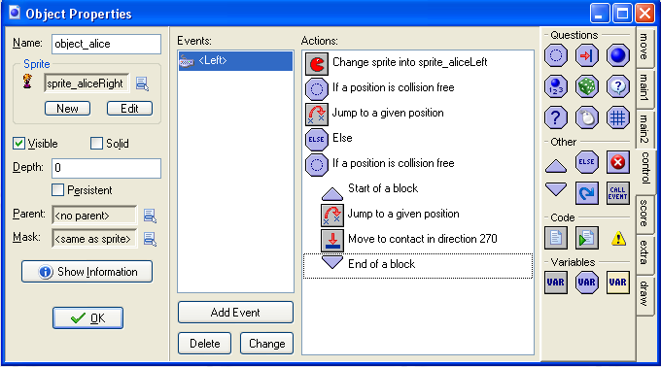
Adding Left Motion (cont)
Finally add a End Block action.
The Keyboard <Left> event should look like below.
Game Development 1.1
Denis McCarthy

Slide 43
Adding Right Motion
Moving to the right is exactly the same as for moving to the left. You can duplicate the Left keyboard event and just change the properties to see up development.
Add a Keyboard, <Right> Key event.
Since it is the right key that has been pressed, we must make sure that the sprite for Alice facing right is displayed on screen. So, add a Change Sprite action and set the sprite to sprite_aliceRight.
We are only going to move Alice right, 4 pixels at a time, so we need to check if the position 4 pixels right is empty. To do this we add a Check Empty action with the x value set to 4, leave all other properties alone.
Game Development 1.1
Denis McCarthy

Slide 44
Adding Right Motion (cont)
If the position at (4, 0) is free relative to Alice, then add a Jump to Position action that moves Alice with X set to 4 and Y set to 0 and with the Relative property enabled.
Otherwise if the position at (4, 0) is not free relative to Alice, (this is separate to a collision event with a block), we need to check if there are steps going up the way (no need to check for steps going down the way, as for this we will move right and fall down, which we will deal with later). We need to check if the relative position (4, -8) is empty, basically the space above a step. So add a Check Empty action, with X set to 4 and Y set to -8.
Game Development 1.1
Denis McCarthy

Slide 45
Adding Right Motion (cont)
There are a number of steps to take if the position is free so add a Start Block action.
If the position at (4, -8) is free relative to Alice, then add a Jump to Position action that moves Alice with X set to 4 and Y set to -8 and with the Relative property enabled.
Just in case Alice is moved to a position that is floating above the step, we need to get her drop down onto the step. To do this we add a Move to Contact action, we set the direction property to 270 (going downwards), set the maximum distance to travel to 8 pixels, and set the property against to solid objects.
Game Development 1.1
Denis McCarthy

Slide 46

Adding Right Motion (cont)
Finally add a End Block action.
The Keyboard <Right> event should look like below.
Game Development 1.1
Denis McCarthy

Slide 47
Collisions
Since we have motion going left and right and there was a bit of work in that, lets take a few simple steps next.
We need to add collision detection for the following:
  Bonus Life
  Level Exit
  Mushroom
  Death Block
  Bird monster
  Ammunition
  Block
  Rabbit monster
Game Development 1.1
Denis McCarthy

Slide 48
Collision: Bonus Life
Create a Collision event with the object_bonusLife object. First we need to play a sound, we don’t have a specific sound in our resources so we’ll have to pick an existing one. Add a Play Sound action and select the sound sound_finishLevel.
Add a Set Lives action and set it relative to 1 (increase the number of lives by 1.
Since our number of lives display isn’t too big (it can only hold around 4 in the display) we need to make sure we don’t introduce too many. Add a Test Lives action to see if the number of lives is greater than 4.
Game Development 1.1
Denis McCarthy

Slide 49
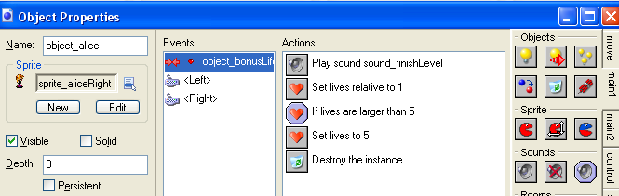
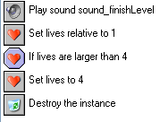
Collision: Bonus Life
If the number of lives is greater than 5, then we need to add a Set Lives action where we set the number of lives to 4.
Finally we need to add a Destroy Instance action to remove the object_bonusLife instance from the game.
Game Development 1.1
Denis McCarthy

Slide 50
Collision: Level Exit
Create a Collision event with the object_levelExit object. Add a Play Sound action and select the sound sound_finishLevel.
We need to give the player a bonus score for reaching the end of the level, so we need to add a Set Score action and give the player an extra 300 points, i.e. relative to their current score.
Add a Next Room action, select which ever transition you want.
Game Development 1.1
Denis McCarthy

Slide 51
Collision: Mushroom
Create a Collision event with the object_mushroom object. Add a Play Sound action and select the sound sound_getMushroom.
Add a Set Score action and give the player an extra 20 points, i.e. relative to their current score.
Finally we need to add a Destroy Instance action to remove the object_mushroom instance from the game.
Game Development 1.1
Denis McCarthy

Slide 52
Collision: Death Block
Create a Collision event with the object_blockDeath object. Add a Play Sound action and select the sound sound_killCharacter.
Add a Set Lives action and set it relative to -1 (decrease the number of lives by 1.
Add a Test Lives action to see if the number of lives is larger than 0. If its not don’t worry, our main controller object will take care of that scenario.
If the number of lives is larger than 0 then add a Restart Room action, once again select any transition that you want.
Game Development 1.1
Denis McCarthy

Slide 53
Collision: Bird Monster
Create a Collision event with the object_bird object. Add a Play Sound action and select the sound sound_killCharacter.
Add a Set Lives action and set it relative to -1 (decrease the number of lives by 1.
Add a Test Lives action to see if the number of lives is larger than 0. If its not don’t worry, our main controller object will take care of that scenario.
If the number of lives is larger than 0 then add a Restart Room action, once again select any transition that you want.
For speed of development duplicate the Death block object.
Game Development 1.1
Denis McCarthy

Slide 54
Ammunition
For a young girl, Alice packs a lot of punch. She even has her own gun, unfortunately she has no ammunition for it.
Within GM when we create an object there are many different variables created that we can work with, such as speed, direction and position on screen (x, y) to name but a few. But there are times when we want to create our own variable to store some value for us.
We are going to create a variable called ammo, this will store the amount of bullets (ammunition) Alice has got left.
Game Development 1.1
Denis McCarthy

Slide 55
Creating a variable
Like all variables we need to create it and assign it an initial value.
In our case this will be set to 0 until Alice finds some ammunition.
Add a Create event to the object_alice. Add a Set Variable action (control tab), set the property variable to ammo and the property value to 0.
We are now free to use this variable whenever we want.
Game Development 1.1
Denis McCarthy

Slide 56
Collision: Ammunition
Create a Collision event with the object_ammunition object. First we need to play a sound, we don’t have a specific sound in our resources so we’ll have to pick an existing one. Add a Play Sound action and select the sound sound_finishLevel.
Add a Set Variable action and to give the player an extra 10 bullets, set the property variable to ammo and the property value to 0.
Finally we need to add a Destroy Instance action to remove the object_ammunition instance from the game.
Game Development 1.1
Denis McCarthy

Slide 57
Displaying Ammo
When Alice picks up the ammo we need to be able to indicate in the display that we have ammo, i.e. by displaying a gun. We need to edit the Draw event of the object_controller_main.
We need to check if Alice has any ammo, so add a Test Variable action that tests if the variable object_alice.ammo is larger than 0.
Add a Draw Sprite action, set the sprite to sprite_ammunition. We need to make sure that the sprite is drawn within a view (more on this later), so set the x value to view_xview+70 and the y value to view_yview+2 and finally set the sub-image to 0.
Game Development 1.1
Denis McCarthy

Slide 58
Collision: Block
Create a Collision event with the object_block object. Add a Move to Contact action, we set the direction property to direction (whatever direction we were going in the first place), set the maximum distance to travel to 12 pixels, and set the property against to solid objects. Effectively stops moving Alice when she hits a brick wall.
Add a Vertical Speed action and set the speed to 0.
This looks like a rather complex way to deal with collision detection, we will see later that a falling Alice is a more complex issue.
Game Development 1.1
Denis McCarthy

Slide 59
Collision: Rabbit Monster
We can collide with the Rabbit monster in two way:
  Walking straight into the Rabbit will kill Alice.
  Jumping/falling on top of the Rabbit will kill the Rabbit
In most platform games we like to make it possible for the character to jump on top of the monster and squash it.
So in the collision event of the character with the monster we must check whether we hit the monster from above to squash it.
To find out we perform the following test:
      vspeed > 0 && y < other.y+8
Game Development 1.1
Denis McCarthy

Slide 60
Collision: Rabbit Monster
      vspeed > 0 && y < other.y+8
It is true if vspeed (referring to Alice’s vertical speed) is larger than 0, so Alice is moving downwards and not just going from side to side, and also Alice is close to the top of the Rabbit Monster (other.y + 8) so it is indeed hitting it from above.
In this case the monster must be destroyed.
We will set up the collision event to check the expression first, if the expression is true we will kill the Rabbit, otherwise if the expression is false we will kill Alice.
Game Development 1.1
Denis McCarthy

Slide 61
Collision: Rabbit Monster
Create a Collision event with the object_rabbit object. Add a Test Expression action and give the expression property vspeed > 0 && y < other.y + 8.
Because we have many actions to take if the expression is true, we will need to add a Start Block action.
To make our event easy to read, we will add a Comment action that we will add the comment “Destroy the Rabbit”.
Add a Play Sound action and select the sound sound_killMonster.
Add a Set Score action and give the player an extra 60 points, i.e. relative to their current score.
Game Development 1.1
Denis McCarthy

Slide 62
Collision: Rabbit Monster
The Rabbit is dead so we need to stop it moving so add a Moved Fixed action with the direction set to centre point (i.e. moving in no direction) with a speed of 0.
Add a Change Instance action, apply it to the other object (i.e. the Rabbit monster), set the change into the dead monster object, and set the perform events to yes.
That’s it for killing the Rabbit so add an End Block action.
Next we need to deal with the situation where the expression is false (Alice walks into the Rabbit), so add an Else action and another Start Block action.
Game Development 1.1
Denis McCarthy

Slide 63
Collision: Rabbit Monster
Once again to make our event easy to read, we will add a Comment action that we will add the comment “Destroy Alice”.
Add a Play Sound action and select the sound sound_killCharacter.
Add a Set Lives action and set it relative to -1 (decrease the number of lives by 1.
Add a Test Lives action to see if the number of lives is larger than 0. If its not don’t worry, our main controller object will take care of that scenario.
If the number of lives is larger than 0 then add a Restart Room action, once again select any transition that you want.
Lastly add an End Block action.
Game Development 1.1
Denis McCarthy

Slide 64
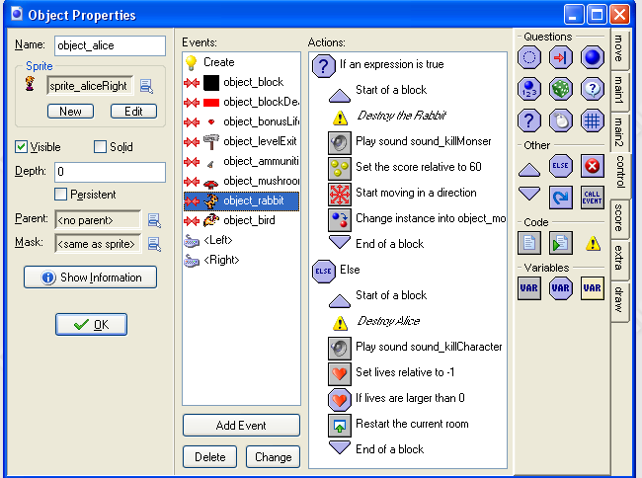
Collision: Rabbit Monster
Game Development 1.1
Denis McCarthy

Slide 65
Remaining events
That’s it for the collisions.
We have so far created 11 of the 16 events needed to complete the Alice character.
Platform games are not as easy as first thought.
We have a number of events left to create:
  Dealing with the possibility that Alice gets outside the room
  Upward movement (climbing ladder/rope, Jumping)
  Downward movement (descending ladder/rope)
  Shooting bullets
  A step event to handle Alice Falling (complex)
Game Development 1.1
Denis McCarthy

Slide 66
Outside Room
There is a possibility that Alice may get outside the bounds of the room (bad level design or deliberate)
Bad level design would be if Alice somehow gets outside the room by getting on top of the boundary walls and taking a leap.
Deliberate design would be a bottomless pit.
In either case we will kill her, and deduct 1 life from the player.
To check to see if Alice is outside the room we test to see if Alice’s Y position is larger than the room height, this variable in GM is known as room_height
Game Development 1.1
Denis McCarthy

Slide 67
Outside room (cont)
Create an Other, Outside Room event. Add a Test Variable action, set the property variable to y, the property value to room_height and set the property operation to larger than. We could have used the Test Expression action if we had wanted to.
Because we have many actions to take if the expression is true, we will need to add a Start Block action. If the expression is true we kill Alice otherwise we do nothing.
Once again to make our event easy to read, we will add a Comment action that we will add the comment “Destroy Alice”.
Game Development 1.1
Denis McCarthy

Slide 68
Outside room (cont)
Add a Play Sound action and select the sound sound_killCharacter.
Add a Set Lives action and set it relative to -1 (decrease the number of lives by 1.
Add a Test Lives action to see if the number of lives is larger than 0. If its not don’t worry, our main controller object will take care of that scenario.
If the number of lives is larger than 0 then add a Restart Room action, once again select any transition that you want.
Lastly add an End Block action.
Game Development 1.1
Denis McCarthy

Slide 69
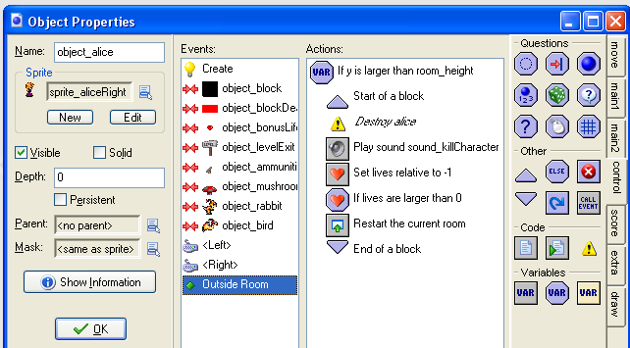
Outside room (cont)
Game Development 1.1
Denis McCarthy

Slide 70
Up motion
Pressing the <Up> key on the keypad will have different effects depending on where Alice is within the level.
  If Alice is on a ladder she will climb up it
  Otherwise if she is not, let her jump into the air but only if she is on solid ground.
We don’t have to worry about jumping in any particular direction, our left and right key events only checks if there is the possibility of a collision. So whatever direction we are moving in we will jump in that direction.
To make Alice jump we will just set her vertical motion. We don’t care how she comes back down again (we will deal with this in the Step event, as it is the same as falling).
Also we will let the Step event to check whether it should change Alice into the climbing sprite.
Game Development 1.1
Denis McCarthy

Slide 71
Ladders
People always want ladders in platform games along which the character can move from one platform to the other. This requires a bit of work.
A ladder will be represented by a thin vertical block.
When the character is not in contact with a ladder, motion should be as before. But when it is in contact with the ladder things must go different.
  First of all, the character should not fall down. So in the step event we have to make a change to this effect adding some actions that set the vertical speed and gravity to 0 when in contact with a ladder. Also we set the sprite to the climbing sprite in that case.
  The second thing that needs to change is the event for the up key. When the character is at a ladder, the up arrow key should move it up, rather than jump. Again we need a few additional actions for this. We test whether the character is in contact with a ladder and, if so, move it up a bit. We use similar actions for the down key.
Game Development 1.1
Denis McCarthy

Slide 72
Up motion (cont)
Add a Keyboard, <Up> Key event. We need to check and see if Alice is on a ladder/rope. To do this we will add a Check Object action and will test if the object_blockLadder is at the same position as Alice so leave the properties x and y alone (leave at 0) and enable the Relative option.
Because we have many actions to take if the expression is true, we will need to add a Start Block action.
Once again to make our event easy to read, we will add a Comment action that we will add the comment “Climb Ladder”.
Game Development 1.1
Denis McCarthy

Slide 73
Up motion (cont)
We are only going to move Alice up, 3 pixels at a time, so we need to check if the position 3 pixels above Alice is empty. To do this we add a Check Empty action with the y value set to -3, leave all other properties alone.
If the position at (0, -3) is free relative to Alice, then add a Jump to Position action that moves Alice with X set to 0 and Y set to -3 and with the Relative property enabled.
That’s it for Alice climbing a rope or ladder so add an End Block action.
Next we need to deal with the situation where the expression is false (Alice is going to jump), so add an Else action and another Start Block action.
Game Development 1.1
Denis McCarthy

Slide 74
Up motion (cont)
Once again to make our event easy to read, we will add a Comment action that we will add the comment “Make Alice jump”.
We need to check if Alice is standing on solid ground before we let her jump so we need to add a Check Collision action, we just need to check directly below Alice if a solid object is there, so set the y property to 1 and the objects property to Only Solid.
If Alice is standing on something then we need to add a Speed Vertical action so as to set her speed to -10. Which effectively makes her fly up the screen. Once again no need to worry about stop her, the Step event will take care of this.
Finally and an End Block action.
Game Development 1.1
Denis McCarthy

Slide 75
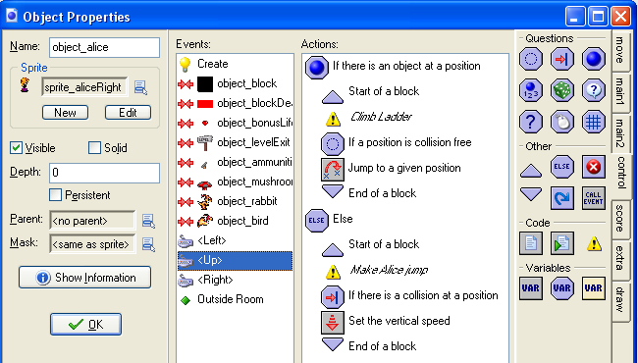
Up motion (cont)
Game Development 1.1
Denis McCarthy

Slide 76
Down motion
Add a Keyboard, <Down> Key event. We need to check and see if Alice is on a ladder/rope. To do this we will add a Check Object action and will test if the object_blockLadder is at the same position as Alice so leave the properties x and y alone (leave at 0) and enable the Relative option.
Because we have many actions to take if the expression is true, we will need to add a Start Block action.
Once again to make our event easy to read, we will add a Comment action that we will add the comment “Descend Ladder”.
Game Development 1.1
Denis McCarthy

Slide 77
Down motion (cont)
We are only going to move Alice down, 3 pixels at a time, so we need to check if the position 3 pixels below Alice is empty. To do this we add a Check Empty action with the y value set to 3, leave all other properties alone.
If the position at (0, 3) is free relative to Alice, then add a Jump to Position action that moves Alice with X set to 0 and Y set to 3 and with the Relative property enabled.
That’s it for Alice descending a rope or ladder so add an End Block action.
Game Development 1.1
Denis McCarthy

Slide 78
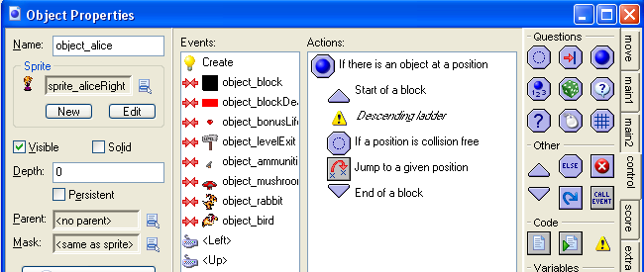
Down motion (cont)
Game Development 1.1
Denis McCarthy

Slide 79
Shooting Monsters
The next step is to enable the player to shoot monsters.
To make things a bit more interesting, the player first needs to find some ammunition to be able to shoot.
To this end we introduced a variable called ammo that indicates how much ammunition the player has.
In the Create event for Alice we set this to 0 using the action to set a variable.
The ammunition object has a simple sprite and does nothing. It just waits to be picked up by the player.
When the character collides with the ammunition object we add 10 to the variable ammo (set it relative to 10) and destroy the ammunition instance.
Game Development 1.1
Denis McCarthy

Slide 80
Shooting Monsters (cont)
Next we created a bullet object. When the player presses the <Space> key an instance of this object must created, assuming there is ammunition, and the value of the variable ammo is decreased by 1.
But there is one important issue. We like the bullet to shoot in the direction the character is facing. To this end we check the value of variable sprite_index.
This variable contains the index (name) of the sprite for the character object.
Based on it we create a bullet with the correct direction of motion. When we are climbing no bullet is created. (Shooting while climbing is not possible.)
Game Development 1.1
Denis McCarthy

Slide 81
Shooting Monsters (cont)
Add a Key Press, <Space> Key event. We need to check and see if Alice has any ammunition. To do this we will add a Test Variable action and will test if the variable ammo is larger than 0.
Because we have many actions to take if the expression is true, we will need to add a Start Block action.
Once again to make our event easy to read, we will add a Comment action that we will add the comment “Shooting Right”.
Game Development 1.1
Denis McCarthy

Slide 82
Shooting Monsters (cont)
We need to check if Alice is facing right, to check this we add a Test Variable action and will test if the variable sprite_index is equal to sprite_aliceRight.
If the test is true then we need to create an instance of the bullet moving to the right. To do this we add a Create Moving action. Within its properties we select the object object_bullet as the object to be created, we set its speed to 12 (making it move fast) we need to enable the Relative property, all other properties are fine as a direction of 0 (angle 0) means a move in the direction of right.
Game Development 1.1
Denis McCarthy

Slide 83
Shooting Monsters (cont)
Once again to make our event easy to read, we will add a Comment action that we will add the comment “Shooting Left”.
We need to check if Alice is facing left, to check this we add a Test Variable action and will test if the variable sprite_index is equal to sprite_aliceLeft.
If the test is true then we need to create an instance of the bullet moving to the left. To do this we add a Create Moving action. Within its properties we select the object object_bullet as the object to be created, we set its speed to 12 (making it move fast) we need to enable the Relative property, and we set a direction of 180 (angle 180) means a move in the direction of left.
Game Development 1.1
Denis McCarthy

Slide 84
Shooting Monsters (cont)
Once again to make our event easy to read, we will add a Comment action that we will add the comment “Decrease ammo”.
We need to decrease the amount of ammunition by 1, so add a Set Variable action and set the variable ammo to -1 and enable the Relative option.
That’s it for Alice shooting a bullet so add an End Block action.
Game Development 1.1
Denis McCarthy

Slide 85
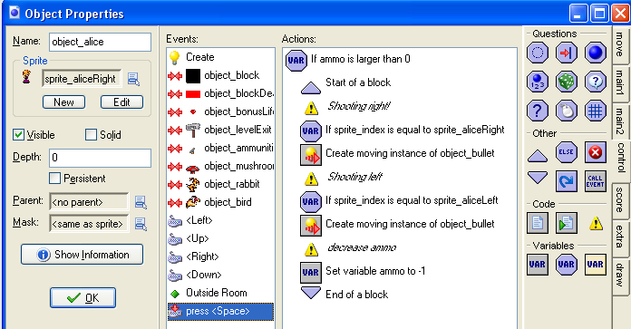
Shooting Monsters (cont)
Game Development 1.1
Denis McCarthy

Slide 86
Final Event
Finally our last event for the object Alice.
This last event must take care of a number of crucial elements of our game play:
  Must check whether Alice is in the air, if so we must make her fall (influence of gravity), this also takes care of the height Alice can jump to as gravity will negate the speed she is going up at, effectively stopping her going up and increasing her speed when she is falling back down.
  Make sure she doesn’t fall too fast.
  Check whether Alice is on the ladder/rope and if so change her sprite to the Alice climbing sprite. This also takes care of when Alice falls onto a ladder or rope.
Game Development 1.1
Denis McCarthy

Slide 87
Alice Step Event
Add a Step, Step event. Once again to make our event easy to read, we will add a Comment action that we will add the comment “Check whether in the air?”.
We need to check if Alice is in the air so we need to add a Check Empty action, we just need to check directly below Alice to see if it is free of solid objects, so set the y property to 1 and the objects property to Only Solid.
If Alice is in the air we need to let the effects of gravity operate on Alice. To do this we need to add a Set Gravity action so as to set her direction to 270 (a downward direction). And set the gravity to 0.5 which effectively adds a downward speed of 0.5 in every step. If Alice is moving up the screen, this will stop her!
Game Development 1.1
Denis McCarthy

Slide 88
Alice Step Event (cont)
Otherwise if Alice is NOT in the air we need to stop the effects of gravity operating on Alice. To do this we need to add a Set Gravity action so as to set her direction to 270 (a downward direction). And set the gravity to 0, you may ask why do we need this action at all, this is needed to stop the effects of gravity when Alice eventually reaches solid ground.
We must stop Alice from falling too fast, otherwise if she goes too fast she may fall into a solid object before GM gets a chance to test if Alice has collided with anything. Once again to make our event easy to read, we will add a Comment action that we will add the comment “Limit the vertical speed”.
Game Development 1.1
Denis McCarthy

Slide 89
Alice Step Event (cont)
We need to check if the vertical speed (falling speed) is larger than 12, we can add a Test Variable action to test if the variable vspeed is larger than 12.
If it is larger than 12 then we add a Set Variable action to set the vertical speed (vspeed) to 12.
Lastly we must check whether Alice is on a ladder or has fallen onto the ladder. We will change Alice’s sprite to the climbing sprite here. Once again to make our event easy to read, we will add a Comment action that we will add the comment “Check whether on a ladder”.
Game Development 1.1
Denis McCarthy

Slide 90
Alice Step Event (cont)
Add a Check Object action that will test if the object_blockLadder is at the same position as Alice so leave the properties x and y alone (leave at 0) and enable the Relative option.
Because we have many actions to take if the expression is true, we will need to add a Start Block action.
If Alice is on the ladder we need to stop the effects of gravity operating on her. To do this we need to add a Set Gravity action so as to set her direction to 270 (a downward direction). And set the gravity to 0.
Game Development 1.1
Denis McCarthy

Slide 91
Alice Step Event (cont)
Since Alice is on the ladder we need to stop her vertical speed that is set it to 0. Add a Set Variable action and set the variable vspeed to 0.
Finally since Alice is on the ladder, we need to change her sprite into the climbing sprite. Add a Change Sprite action to change the sprite to sprite_aliceClimbing.
That’s it for checking whether Alice is on a ladder so add an End Block action.
Game Development 1.1
Denis McCarthy

Slide 92
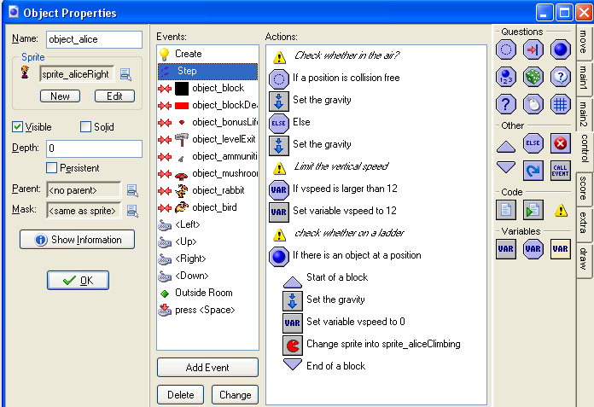
Alice Step Event (cont)
Game Development 1.1
Denis McCarthy

Slide 93
Objects complete
Finally we have finished creating all of our objects (that was a lot of work).
Now we need to create a test room to test out all of our work.
Create a test like in the example on the next slide
Game Development 1.1
Denis McCarthy

Slide 94
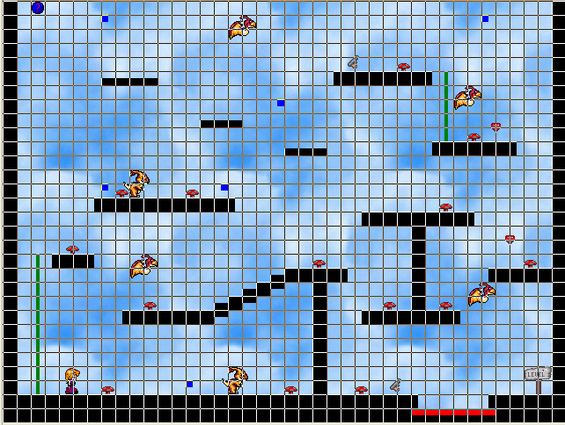
Test Room
Game Development 1.1
Denis McCarthy

Slide 95
Views
Up to now we always showed the entire room. For many platform games this is not what you want.
Instead you want to see only a part of the room, around the character you are controlling.
This makes the game more challenging because the player must try to detect their way through the platforms.
You can also hide prizes at difficult to reach places in the room.
Fortunately this is extremely simple to achieve in Game Maker.
Game Development 1.1
Denis McCarthy

Slide 96
Views (cont)
When designing the room, click on the views tab.
Click on the checkbox Enable the use of Views to start using views.
Select the first view and check the box Visible when room starts to make sure this view can be seen.
Give it a width of 300 and a height of 200 (or something else that you like). (As we are going to let the view follow the character there is no need to specify the left and top position of the view in the room. Also, because we use just one view, we don't have to specify the x and y position of the port on the screen.)
Game Development 1.1
Denis McCarthy

Slide 97
Views (cont)
At the bottom we can indicate which object to follow.
Here we choose the object Alice. The view will now automatically move to keep the character in focus.
We don’t want the character to get too close to the border.
To this end we set the Hbor and Vbor values to 64. There will now always be a 64 pixel area visible around the character.
Finally, to get a smooth view motion we set the maximal view speed to 4. (This also gives a very nice effect at the start because the character comes slowly into view.)
Game Development 1.1
Denis McCarthy

Slide 98
Views (cont)
Having the view is nice but it makes the window in which things happen rather small.
Clearly you can play with these values to get the effect you want.
Using views can create split screen effects and the like.
Game Development 1.1
Denis McCarthy

Slide 99

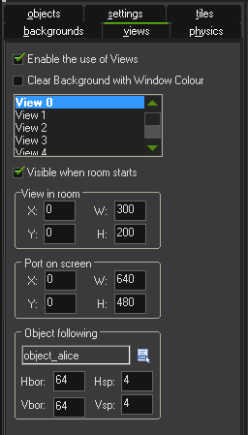
Views (cont)
Game Development 1.1
Denis McCarthy

Slide 100
Test
You will need to perform extensive testing to make sure everything works correctly.
When laying the blocks, at times it is best to set the snap x and y to 8 pixels each, do this when creating the steps as it makes life easier, and also use this when putting in the horizontal and vertical blocks.
It may take you a while to fully test the game.
You may notice that the graphics on screen do not look the best.
Game Development 1.1
Denis McCarthy

Slide 101
Tiles
We want to improve the look of the platforms.
Here we use a standard technique. Rather than using objects for all the different wall and floor elements, we use so-called tiles.
Tiles are pieces of background images that are drawnat particular places in the room.
They do not have associated events nor do they create collision.
The good part is that they are fast and use little memory.
So you can create large rooms without the need for large images.
Game Development 1.1
Denis McCarthy

Slide 102
Tiles (cont)
To add tiles to your rooms you first need a background image that contains the tiles.
Tiles in a background image preferably have a fixed size and have a little (1-pixel) border between them such that they can easily be separated.
A small tile set is provided in the Background resource. Just to explain a little bit about the tile background.
We add it as a transparent background resource named background_tiles.
When adding it to the game, in the background properties indicate that it should be used as a tile set and fill in the correct tile size andseparation, as follows:
Game Development 1.1
Denis McCarthy

Slide 103
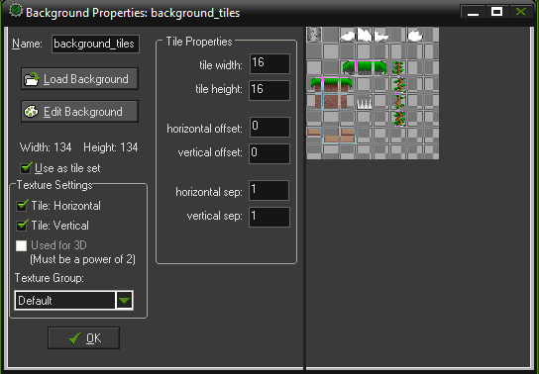
Tiles (cont)
Game Development 1.1
Denis McCarthy

Slide 104
Tiles (cont)
Now, when creating a room, you can click on the tiles tab page.
You can select the tile set (that is, the appropriate background resource).
Now you can draw tiles by clicking on the appropriate tile and next placing them in the room, like you would do for objects. The right mouse button deletes tiles.
Use your imagination to create challenging rooms.
(Note that you can place tiles on different depth layers by adding layers. For example, you can make a layer of tiles that lie in front of the moving characters. We will not use them here but they are great for giving a better 3D effect.)
Game Development 1.1
Denis McCarthy

Slide 105
Tiles (cont)
There is a problem left though. As indicated previously, tiles are just nice graphics.
They do not generate events or collisions. So the character would fall straight through them.
To avoid this we still need the block objects we had before.
We place appropriate walls, platforms, rope vines and deathly spikes tiles on top of the block objects already created.
Now by making the block objects invisible you will not see the black blocks but the beautiful tiles.
But the block objects are actually there, so the character cannot pass through the walls and will land on the platforms.
Our platform should look as follows:
Game Development 1.1
Denis McCarthy

Slide 106
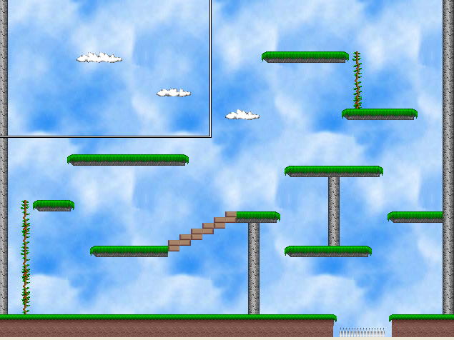
Test room tiles
Our test room tiles will look like the following:
Game Development 1.1
Denis McCarthy

